Slide 1
Lesson 18
Objectives: At the end of this lesson, you will learn Opposites.
Students will learn how to distinguish between masculine and feminine objects
Students will learn how to say “ and” in Arabic

Slide 2
Reviewing greetings and introductions
How do you say: Hello, my name is…..?
What is your name?

Slide 3
Reviewing greetings and introductions
How do you say: Where are you from?
I am from..

Slide 4
Reviewing greetings and introductions
How do you say: I have a chicken.
Do you have a pen? (F)

Slide 5
Reviewing greetings and introductions
How do you say: Good bye:
Good morning:
Welcome:

Slide 6

شُكْرًا
Thank You
How do you say: I am,
you are (F.M),
he is, she is

Slide 7
MAY I HAVE-مُمكِن
May I have
……?

Slide 8
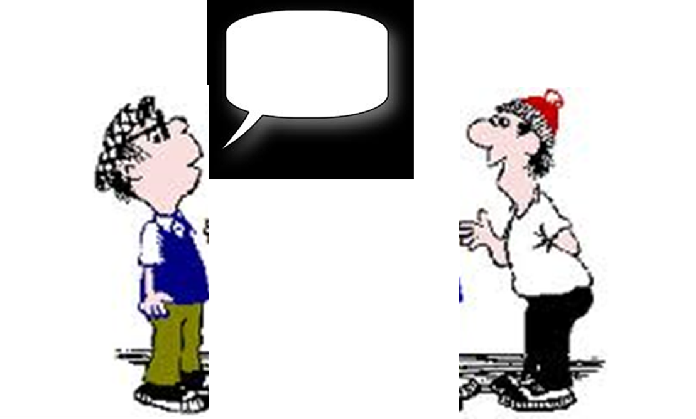
YOUR?…(MASCULINE)-...كَ
This is yours…

Slide 9
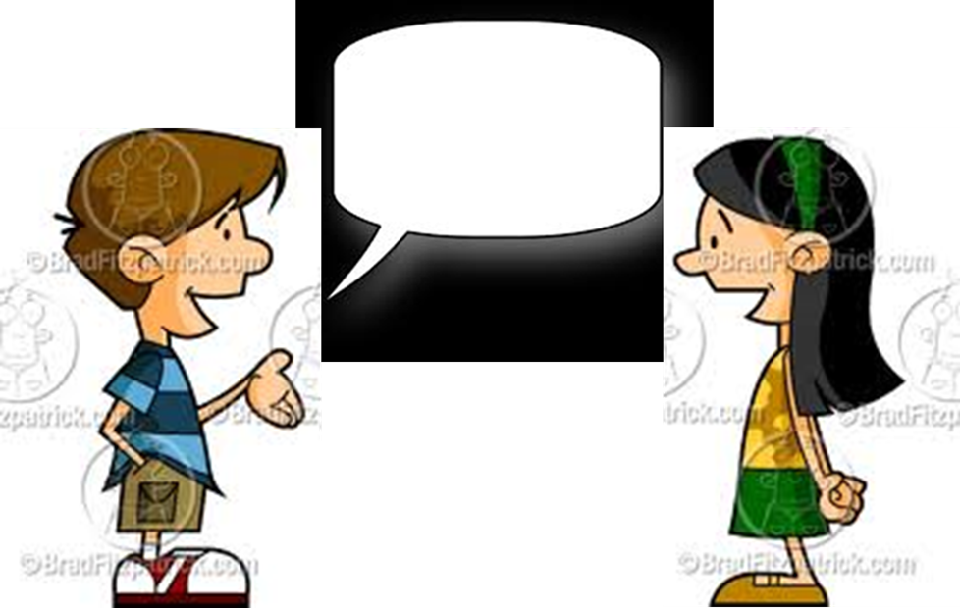
HER-...هَا
This is her…

Slide 10
HIS-...هُ
This is his…

Slide 11

YOUR?(FEMININE)-...كِ
This is yours…

Slide 12

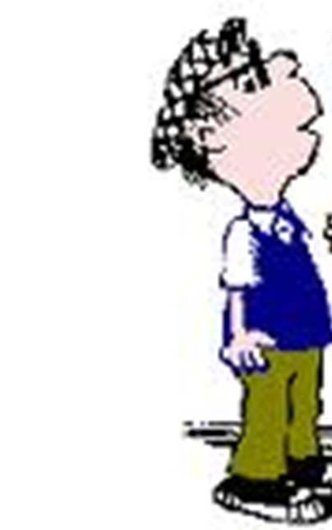
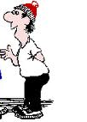
PLEASE (TO A MALE)-مِن فَضْلَك
Please!

Slide 13
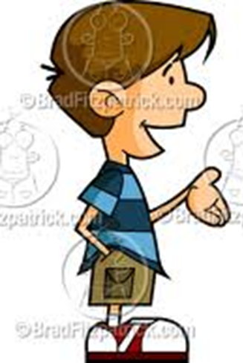
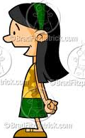
PLEASE (TO A FEMALE)-مِن فَضْلِك

Slide 14
Here you are (to male)-تَفَضَّل
Here!
Here !

Slide 15
I’D LIKE-أُريد
I’d like…..

Slide 16
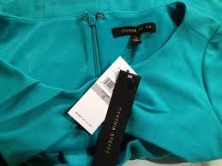
New-جَديد
How do you say: this shirt is new?

Slide 17

OLD-قَديم
How do you say: this map is old?

Slide 18
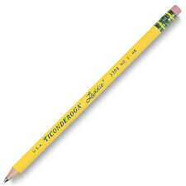
Whole/unbr oken-سَليم
How do you say: this pen is whole?

Slide 19
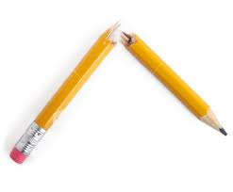
Broken-مَكْسٌور
How do you say: this pen is broken?

Slide 20
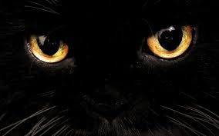
أسْوَد
Black

Slide 21
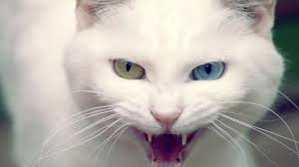
-أبْيَض
White

Slide 22

LIGHT(WEIGHT)-خَفيف

Slide 23
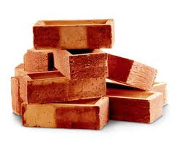
Heavy ثقيل

Slide 24
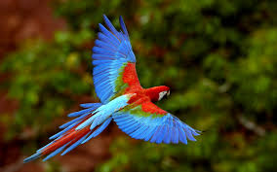
BEAUTIFUL-جَميل

Slide 25
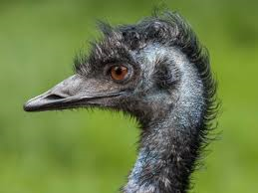
UGLY-قَبيح

